Slide 1
Program Structure

Slide 2
Contents
Program Workflow
Selection Screen
Parameters
Select Options
Time to Practice

Slide 3
Program Workflow

Slide 4
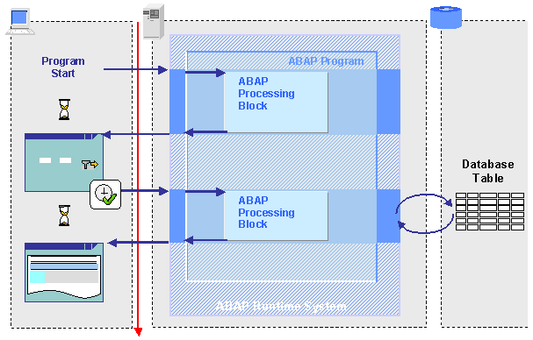
Program workflow
Presentation Layer
(interaction layer)
Application Layer
(processing layer)
Database Layer
ABAP programs are database-independent

Slide 5
Program structure
When a program is written in ABAP the following sections need to be identified (OBS: the order matters!)
REPORT... -> Program start (default syntax during program creation)
TYPES:… -> Type declaration (all TYPES should be declared in a single unified section at the beginning of the program)
DATA:... -> Data declaration (all DATA should be declared in a single unified section at the beginning of the program, after TYPES as they may need local defined types)
SELECTION-SCREEN -> Parameters and select-options
... -> Start of processing (Select, Process and Display information)

Slide 6
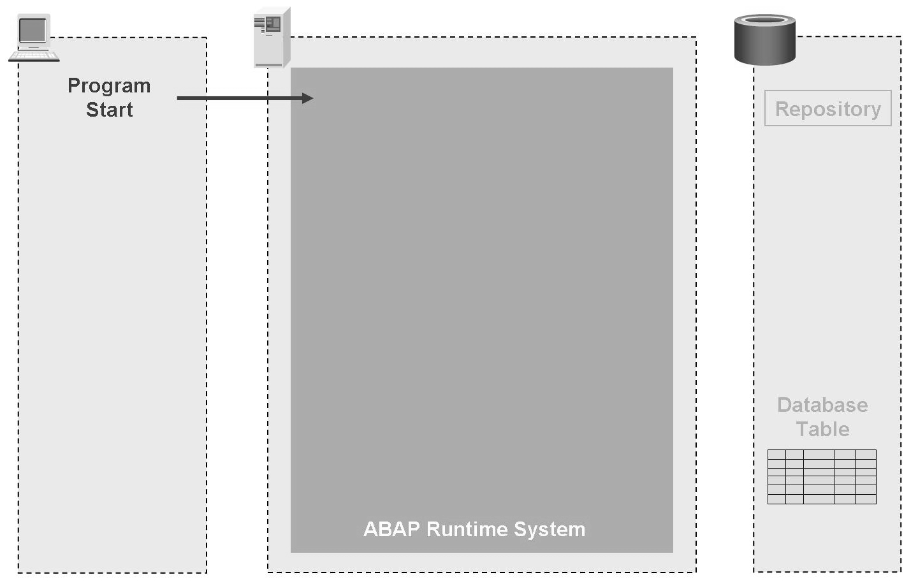
PROGRAM FLOW
Program start

Slide 7
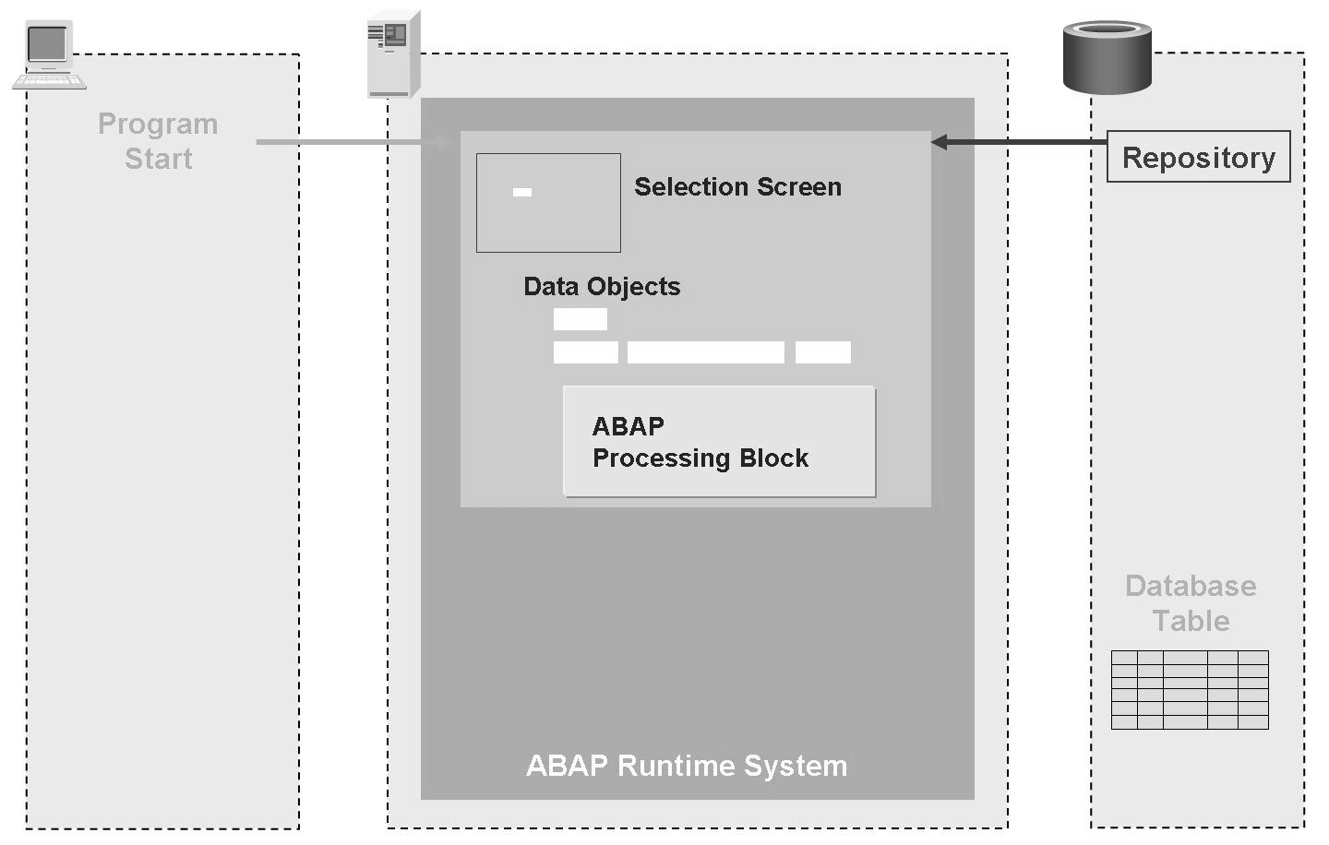
PROGRAM FLOW
System Loads Program Context

Slide 8
PROGRAM FLOW
Runtime System Sends Selection Screen

Slide 9
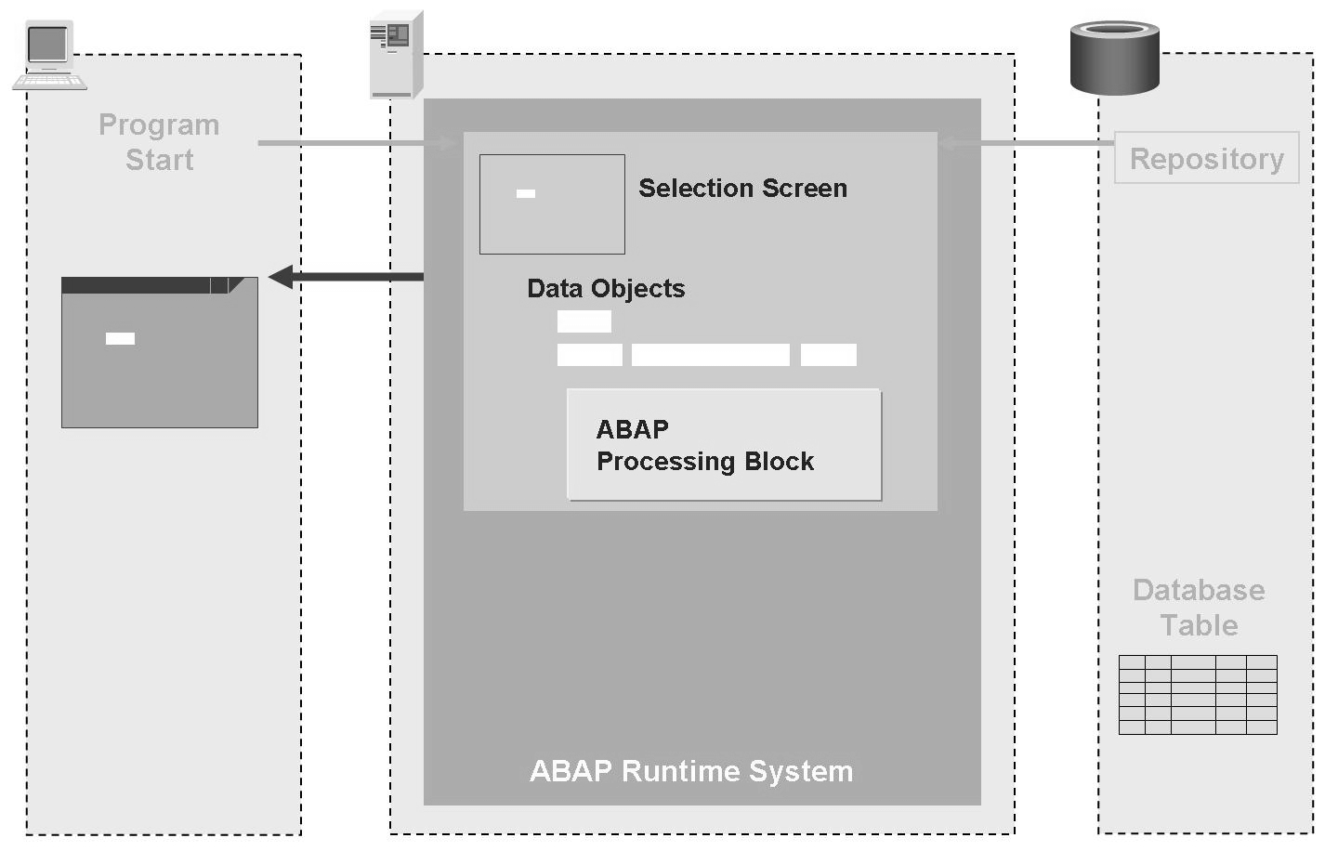
PROGRAM FLOW
Runtime System Sends Selection Screen

Slide 10
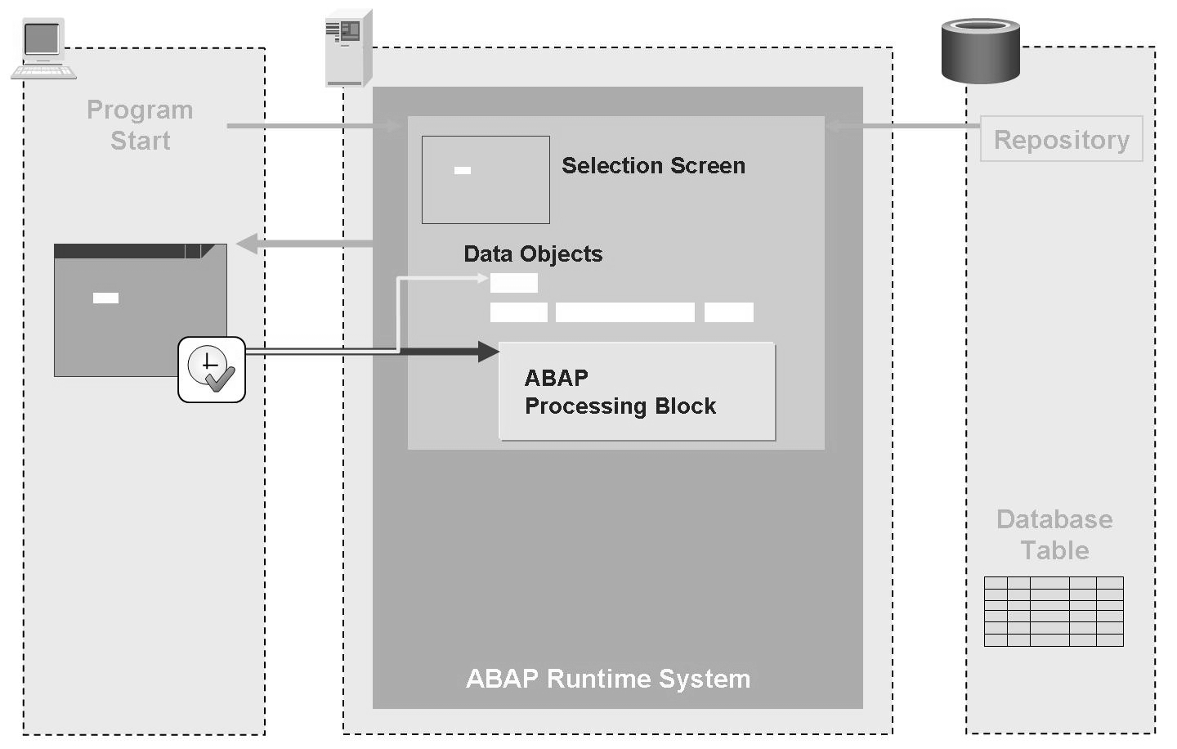
PROGRAM FLOW
Input Values Are Inserted into Data Objects

Slide 11
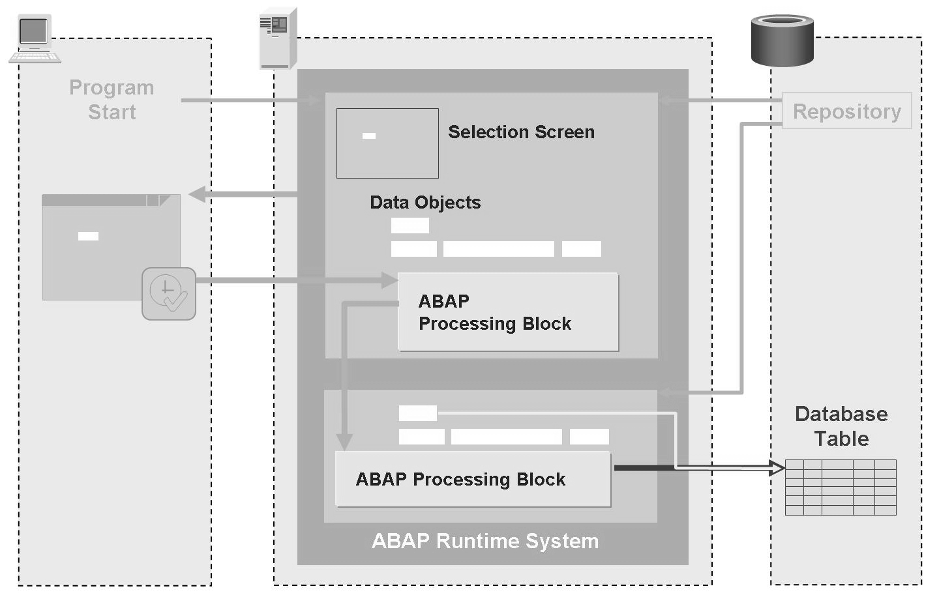
PROGRAM FLOW
Program Requests Data Record from the Database

Slide 12
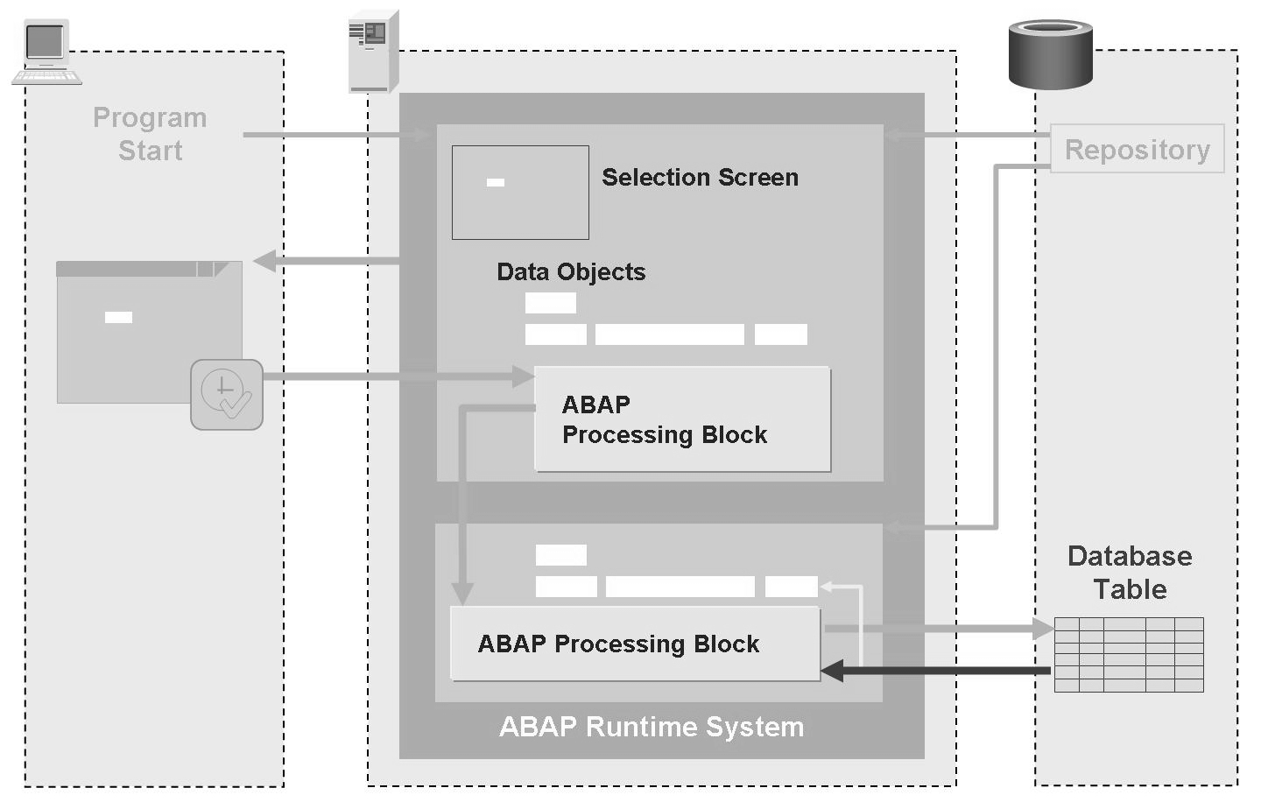
PROGRAM FLOW
Database Supplies the Data Record

Slide 13
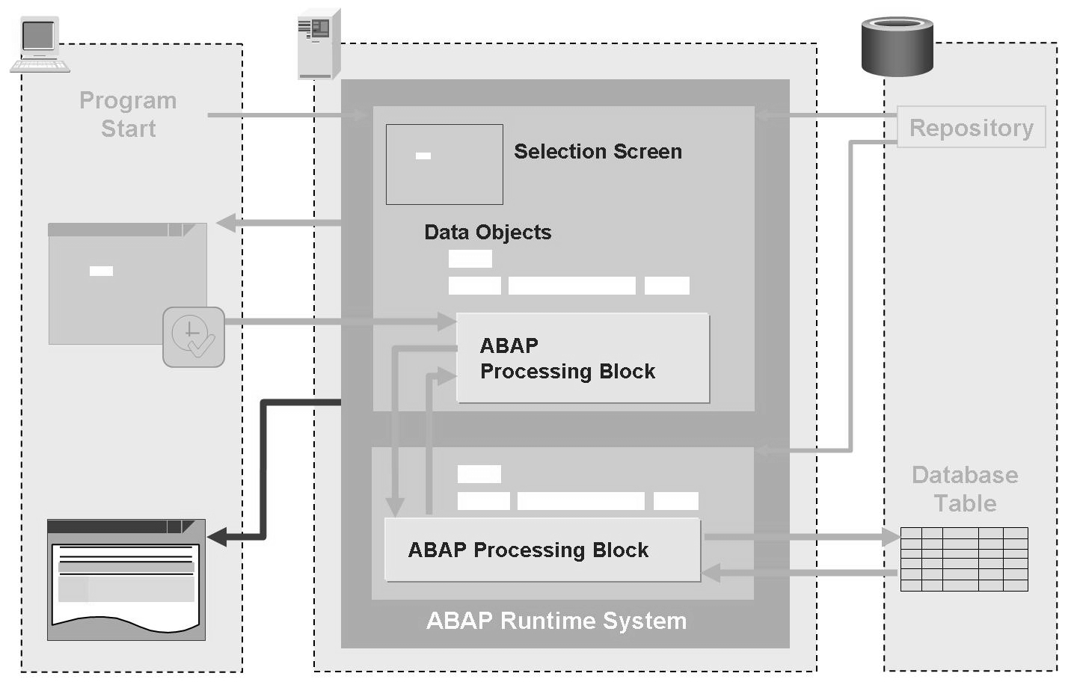
PROGRAM FLOW
Runtime System Sends the Data

Slide 14
Selection Screen

Slide 15
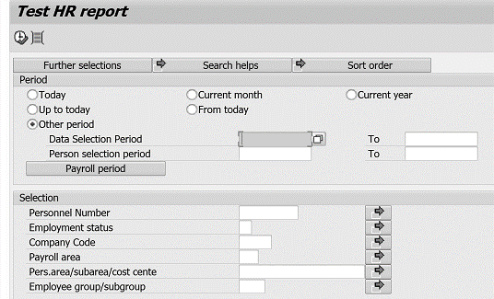
SELECTION-SCREEN elements
Buttons
Radio Buttons
Check Box
SELECT-OPTIONS
(Intervals)
PARAMETERS
(One Value)
Elements can be grouped in
Frames with Titles

Slide 16
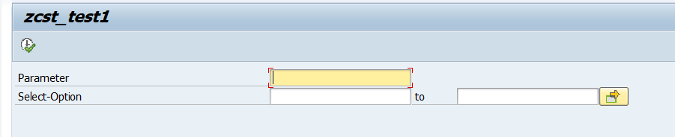
SELECTION-SCREEN elements
The main purpose of Selection Screens is dynamic selections. Selection are rarely made with fix input (eg: select flights for Carrier LH), but with dynamic input (eg: select flights for a specific carrier, entered by the user). In this way dynamic reports can be generated.
For Designing the Selection Screen the main elements are:
PARAMETERS – single value input (eg: select flights for a specific carrier)
SELECT-OPTIONS – interval input (eg: select flights for a time period)

Slide 17
SELECTION-SCREEN - Parameters
You use the PARAMETERS statement to declare variables, similarly to the DATA statement. Variables declared with the PARAMETERS statement are called parameters. For each parameter declared, an input field appears on the corresponding selection screen.
PARAMETERS <p> TYPE <type> [LENGTH len] [DECIMALS dec]
To assign a default value to a parameter, you use the following syntax:
PARAMETERS <p> ...... DEFAULT <f> ......
To make a parameter obligatory :
PARAMETERS <p> ...... OBLIGATORY.

Slide 18
SELECTION-SCREEN - Parameters
PARAMETERS p_int TYPE i OBLIGATORY.
PARAMETERS: p_val TYPE c LENGTH 10 DEFAULT ‘ABC’.
PARAMETERS: p_num TYPE n,
p_date TYPE d DEFAULT sy-datum.
WRITE: p_int, p_val, p_num, p_date.

Slide 19
SELECTION-SCREEN – Parameters
* DATA declaration
DATA s_scarr TYPE scarr.
* Selection Screen
PARAMETERS p_carrid TYPE scarr-carrid DEFAULT ‘LH’ OBLIGATORY.
* Start of Processing
SELECT SINGLE *
INTO CORRESPONDING FIELDS OF s_scarr
FROM scarr
WHERE carrid = p_carrid.
IF sy-subrc = 0.
WRITE: s_scarr-carrname.
ENDIF.
OBS: If parameter initial nothing is selected!!

Slide 20
SELECTION-SCREEN – Select-options
Used for complex selections from database (SELECT)
Can have multiple values (single values or intervals)
SELECT-OPTIONS <seltab> FOR <f>.
<f> can be a column of a database table, or
an internal <f> field in the program. A selection table is an internal table object of the standard DB table type that has a standard key and a header line. Selection tables are used to store complex selections using a standardized procedure.

Slide 21
SELECTION-SCREEN – Select-options
Checking Selection Criteria
Use the following logical expression to check whether the contents of a field satisfy the criteria in a selection table:
... <f> IN <seltab> ....

Slide 22
SELECT-OPTIONS structure
The row type of a selection table is a structure that consists of the following four components: SIGN, OPTION, LOW and HIGH.
• SIGN – Type C length 1
Possible values are I and E.
– I stands for “inclusive” (inclusion criterion - operators are not inverted)
– E stands for “exclusive” (exclusion criterion - operators are inverted)
• OPTION - Type C with length 2.
Possible values:
– If HIGH is empty, you can use EQ, NE, GT, LE, LT,CP, and NP. These operators are the same as those that are used for logical expressions.
– If HIGH is filled, you can use BT (BeTween) and NB (Not Between).

Slide 23
SELECT-OPTIONS structure
• LOW
The data type of LOW is the same as the column type of the database table, to which the selection criterion is linked.
• HIGH
The data type of HIGH is the same as the column type of the database table, to which the selection criterion is linked.

Slide 24
SELECTION-SCREEN – Select-options
TABLES: scarr.
* DATA declaration
DATA v_carrid TYPE scarr-carrid.
* Selection Screen
SELECT-OPTIONS so_cid FOR scarr-carrid.
* Start of Processing
v_carrid = ‘LH’.
IF v_carrid IN so_cid.
WRITE : ‘Valoarea se afla in SELECT-OPTION’.
ENDIF.
OBS: TABLES syntax is needed in order to declare the Type of Select Option.

Slide 25
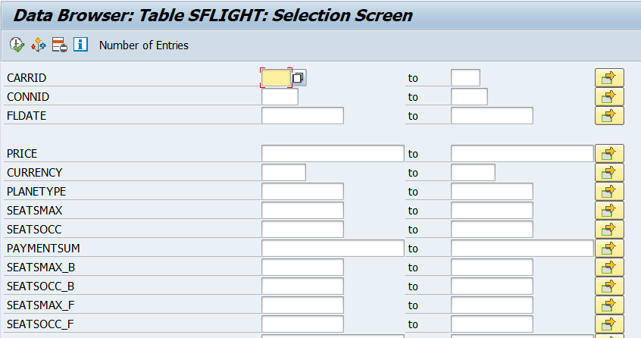
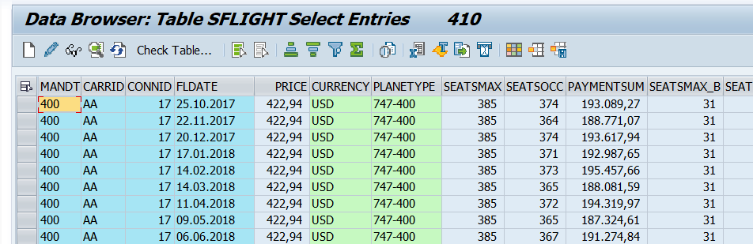
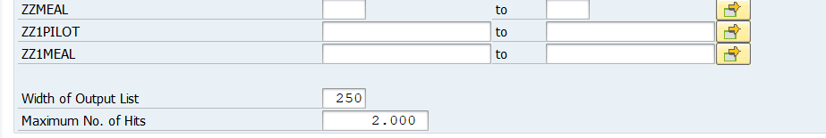
SELECTION-SCREEN – Select-options
Go to ABAP Dictionary (SE11) and access table SFLIGHT. All fields are represented as Select-Options. Leave fields empty (no filter condition) and execute. All records from table are selected. If Select-Option is initial all records are selected.
OBS: Change Maximum No. of Hits (up to N rows)

Slide 26
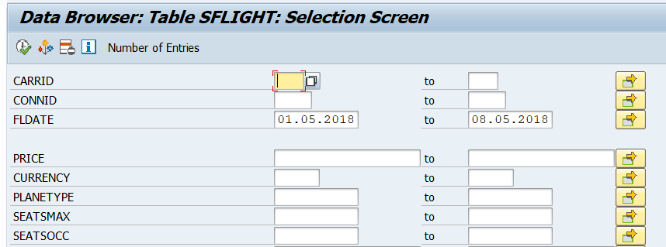
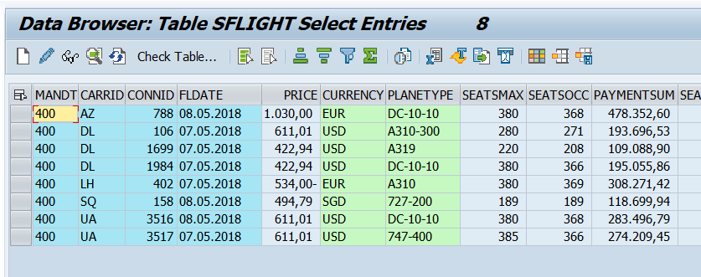
SELECTION-SCREEN – Select-options
Display only the flights operated on the first 8 days of May 2018. Fill the FLDATE select options as follows:
LOW value = 01.05.2018
HIGH value = 08.05.2018
SIGN = ‘I’ – default value; no action needed
OPTION = ‘EQ’ – default value; no action needed

Slide 27
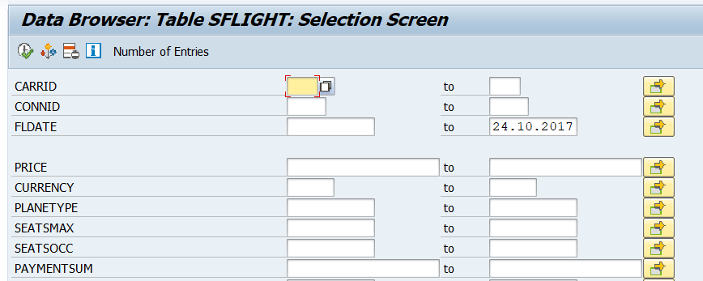
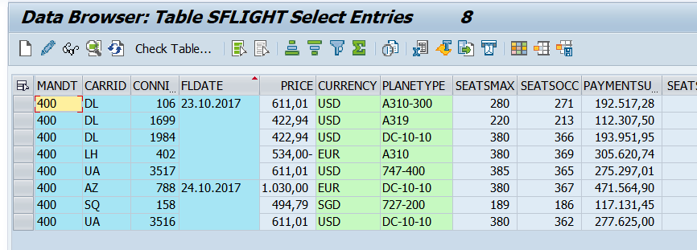
SELECTION-SCREEN – Select-options
Display all flights operated until 24.10.2017. Fill Only the HIGH value. All records until 24.10.2017 are selected (in this eg. oldest flight is on 23.10.2017).

Slide 28
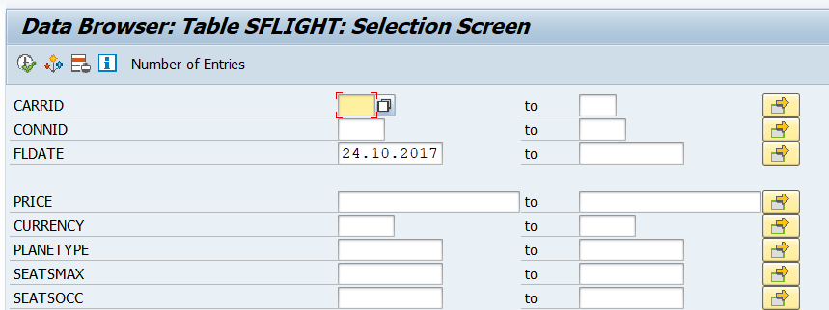
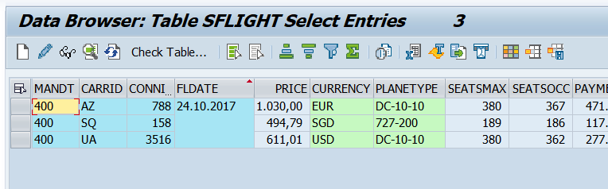
SELECTION-SCREEN – Select-options
Display all flights operated on 24.10.2017. Fill Only the LOW value. All records on 24.10.2017 are selected. In this case the Select-Option has the same behavior as a Parameter.

Slide 29
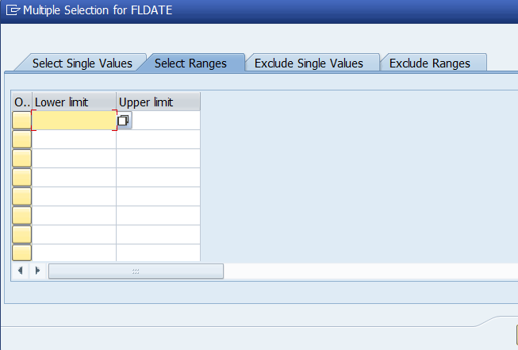
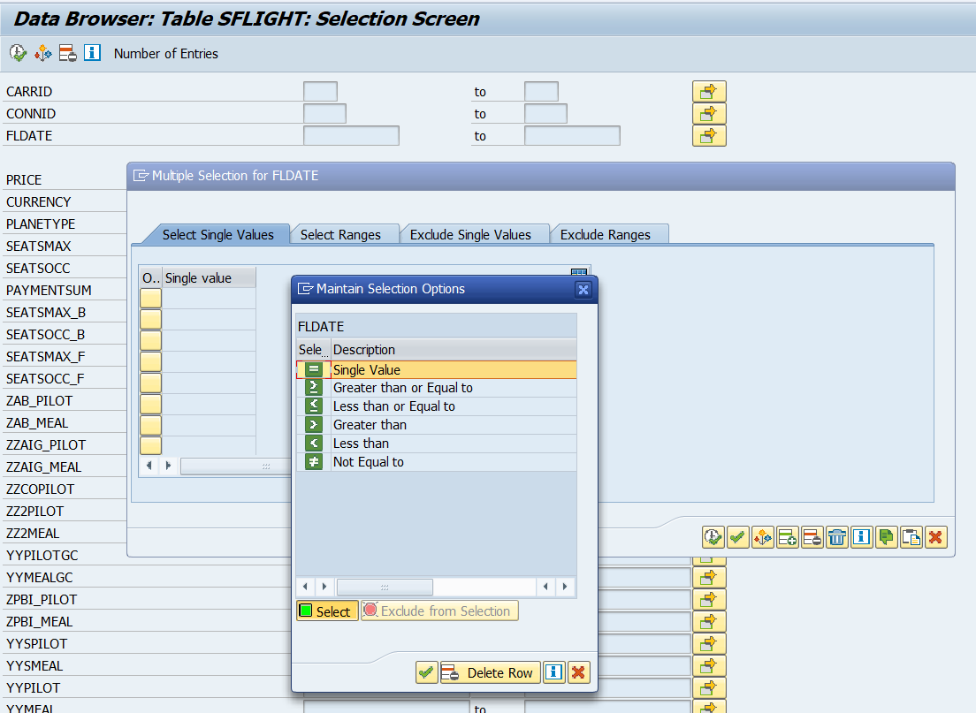
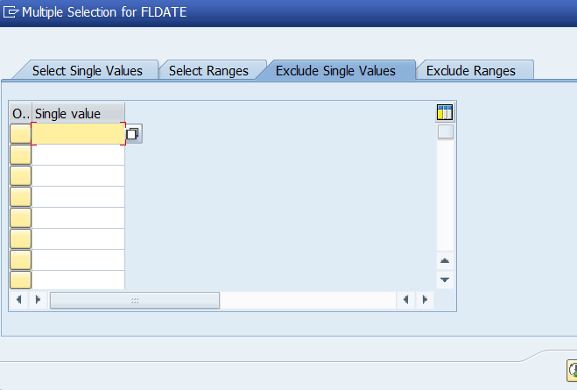
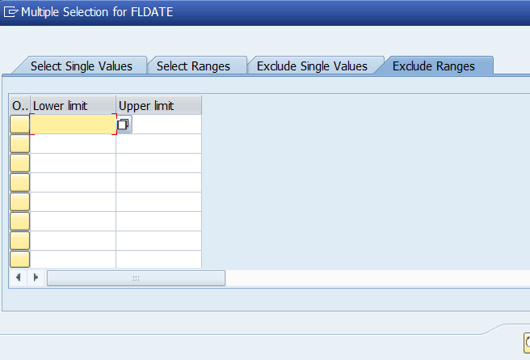
SELECTION-SCREEN – Select-options
By default SIGN = ‘I’ and OPTION = ‘EQ’. If these need to be changed:

Slide 30

SELECTION-SCREEN – specific Parameters
Specific types of PARAMETERS are Check Boxes and Radio Buttons.
Check Boxes and Radio Buttons are specific parameters of type C, and can take only 2 values:
Space – if the parameter is not marked
‘X’ or ‘x’ – if the parameter is marked
PARAMETERS <p> AS CHECKBOX.
PARAMETERS: <p1> RADIOBUTTON GROUP <group>,
<p2> RADIOBUTTON GROUP <group> [DEFAULT ‘X’].
OBS: At least two Radio Buttons must be part of a Group and one Radio Button must always be selected. If not specified, the first radio button is selected by default.

Slide 31
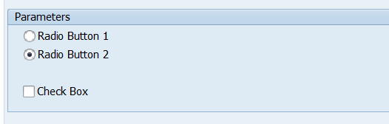
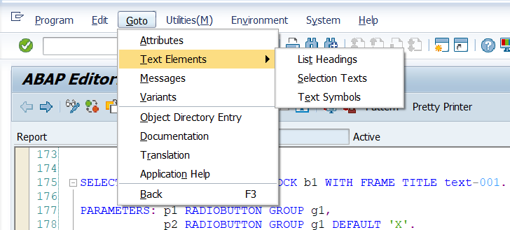
SELECTION-SCREEN – example
SELECTION-SCREEN BEGIN OF BLOCK b1 WITH FRAME TITLE text-001. PARAMETERS: p1 RADIOBUTTON GROUP g1, p2 RADIOBUTTON GROUP g1 DEFAULT 'X’. SELECTION-SCREEN skip 1.
PARAMETERS p3 AS CHECKBOX. SELECTION-SCREEN END OF BLOCK b1.
All elements are in a
Block with Frame
OBS: For Descriptions
Go To -> Text Elements
(read about Text Symbols)

Slide 32
Time to Practice

Slide 33
Time to Practice: Exercise
1.Create a new program named ZZuser_C6 (user is your login user; eg:g001) and define the following selection-screen:
2. Display carrier ID and carrier name for the entries found in P_CARRID;
3. Select the first p_row flights ( table SFLIGHT ) and display them;
4. Display the following information for p_carrid :
- carrier ID ( SCARR-CARRID )
- carrier_name (SCARR-CARRNAME)
- connection_id (SFLIGHT-CONNID)
- flight_date (SFLIGHT-FLDATE)
- seats_occ (SFLIGHT-SEATSOCC)
If no flight was found, display only the carrier name.
Select name | Data type | TYPE | Mandatory | Default | Description
p_carrid | SPFLI-CARRID | Parameter | X | LH | Airline code
s_connid | SFLIGHT-CONNID | Select option |  |  | Flight Connection Number
p_row | i | Parameter |  |  | Number of records selected

Slide 34
Time to Practice: Exercise
5. Display the carrier id, carrier name, connection ID ,country from, country to for P_CARRID. Tables are SCARR and SPFLI . Display the information only if the connection is found for the given carrier.
6. Display the charter flights ( SPFLI-FLTYPE = ‘X’ ). Fields to be displayed: carrid, connid, city from, city to.
7. Add the select-options S_FLDATE on the selection screen.
For the select-options S_CONNID , S_FLDATE and P_CARRID , display the following information about the aircraft type : carrid, connid, fldate, planetype, speed, speed unit, producer. Put the entries in the internal table gt_planes.
Hint: use tables SFLIGHT and SAPLANE.

Slide 35
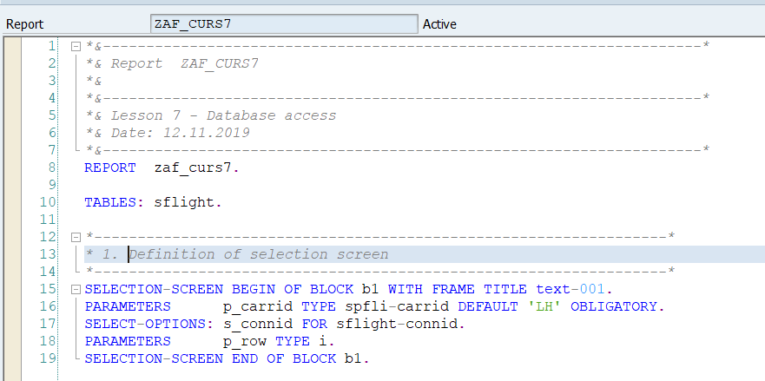
Solution point 1

Slide 36
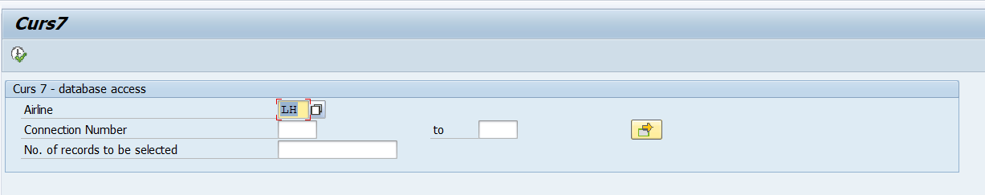

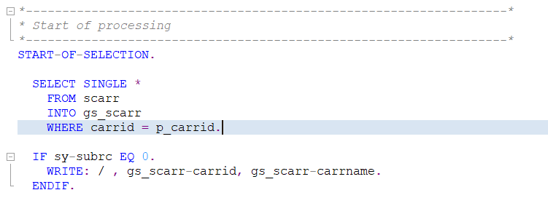
Solution point 2
Solution point 2:

Slide 37
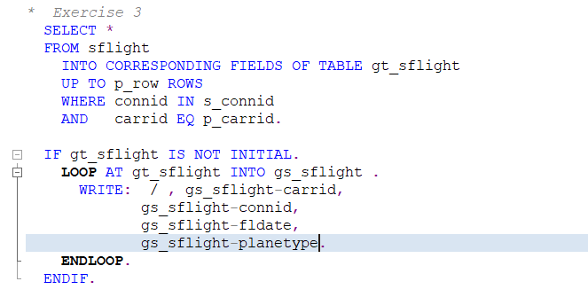
Solution point 3

Slide 38
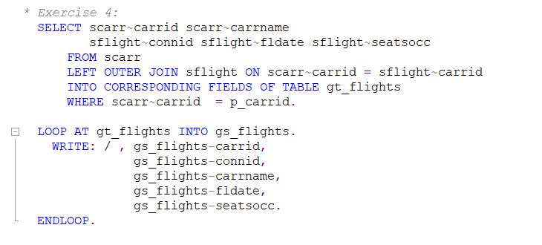
Solution point 4

Slide 39
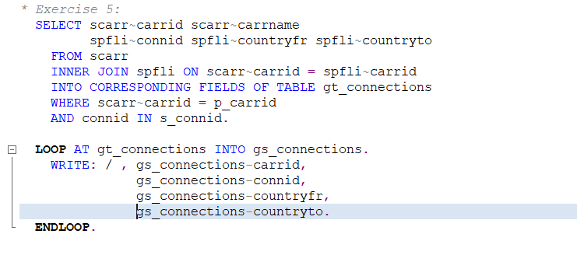
Solution point 5

Slide 40
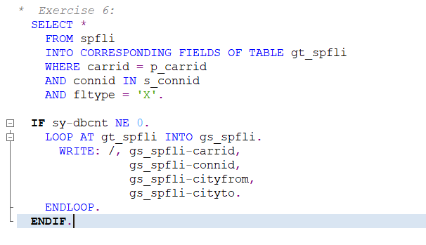
Solution point 6

Slide 41
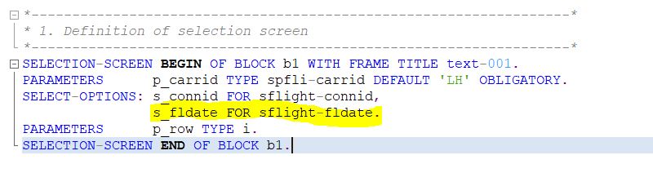
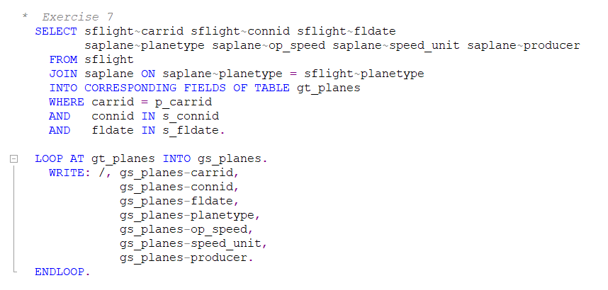
Solution point 7

Slide 42
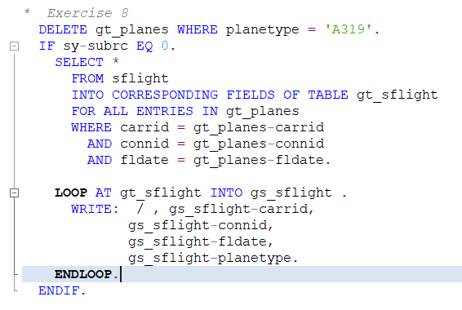
Solution point 8

Slide 43
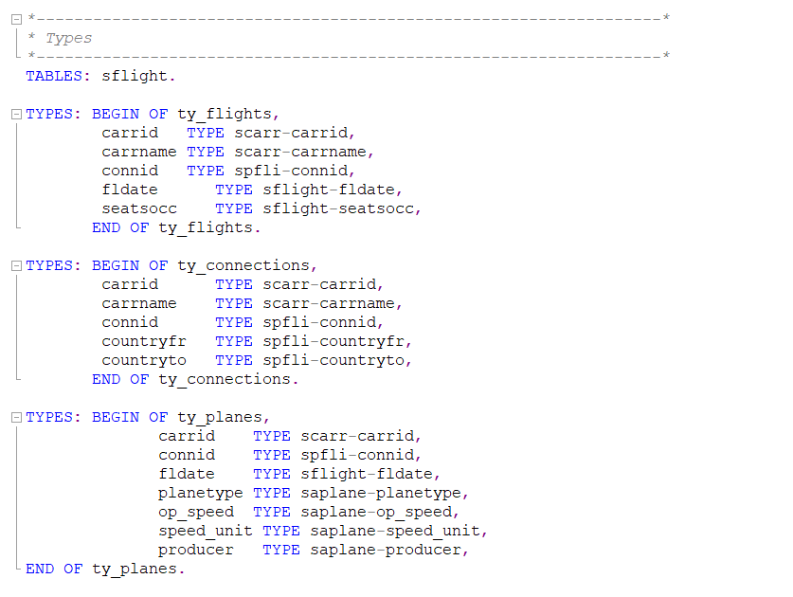
Types and data declarations 1

Slide 44
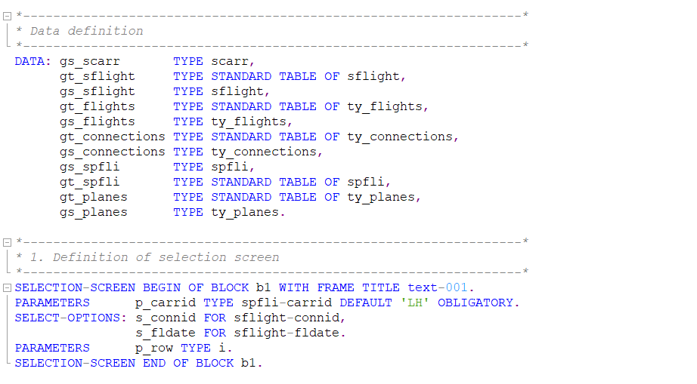
Types and data declarations 2

